Slide 1
Srishti Dixit
Class Spring 2024
Master’s Computer Science
City College of New York

Slide 2
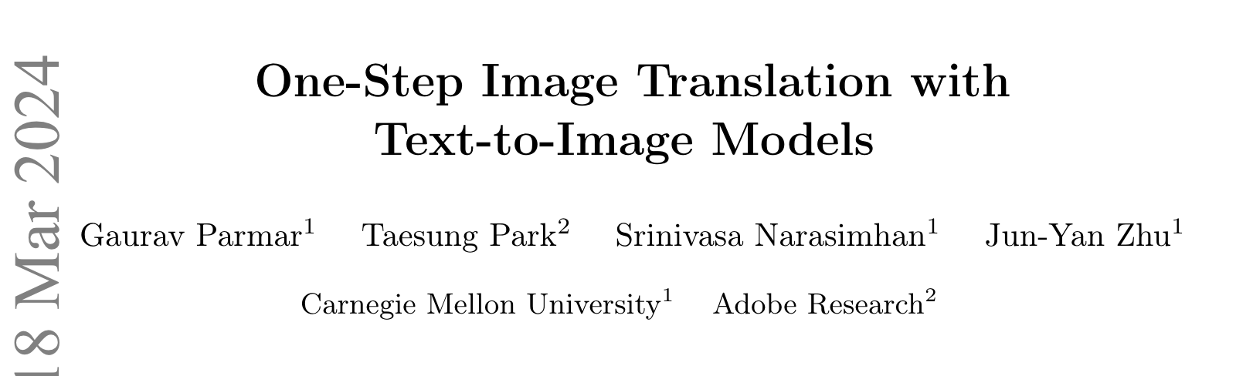
Paper: https://arxiv.org/pdf/2403.12036

Slide 3
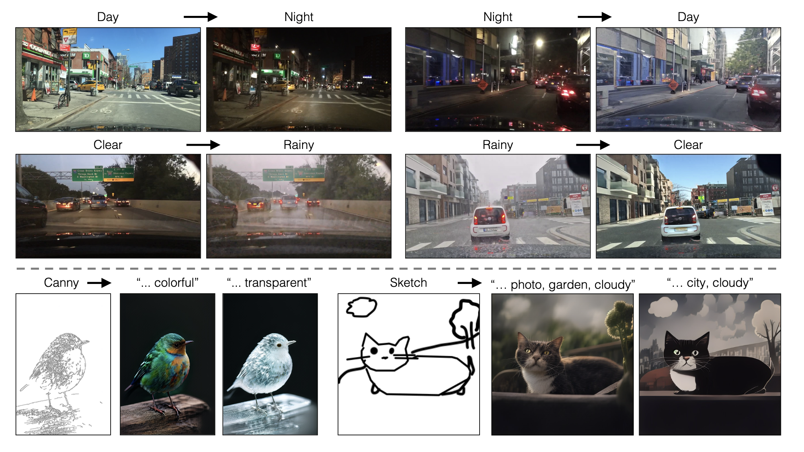
One-Step Image Translation with Text-to-Image Models

Slide 4
Understanding the Motivation
Exploring the Realm of One-Step Image Translation with Text-to-Image Models
Driving Forces:
The quest to revolutionize image translation technology.
Making image translation faster and more efficient.
Reducing reliance on extensive datasets to make the technology more accessible.

Slide 5
Identifying the Challenge
Image translation methods currently face two major hurdles.
Time Constraint: These methods are notably time-consuming due to their multi-step nature.
Data Requirement: They heavily rely on extensive datasets for effective learning.

Slide 6
Envisioning the Transformation
Potential Impact: A successful solution holds the promise of transformative effects across various domains.
Streamlined Processes: From artistic endeavors to practical applications like medical imaging, faster image translation can significantly streamline processes.
Broader Implications: Beyond specific applications, advancing image translation technology can open doors to novel innovations and possibilities.

Slide 7
Understanding the Accomplishments
Non-Technical Accomplishments:
First model to perform image translation in just one step.
Reduces reliance on extensive training datasets, making it more accessible.
Technical Accomplishments:
Successfully combined text and image information in a single-step model.
Achieved faster image translation without compromising quality or detail.

Slide 8
Evolution of Image Transformation
Historical Background:
Traditional image transformation methods involved multi-step processes, leading to slow performance.
Previous approaches required extensive training data, posing challenges in data acquisition.

Slide 9
Method Refinement
Successfully integrated text and image information into a single-step model.
Addressed challenges related to noise handling in one-step models, ensuring accurate image translation.
Maintained image quality and detail while significantly improving speed.

Slide 10
Innovation Highlights
Amalgamation of various model components into a unified framework
Special emphasis on preserving fine details crucial for maintaining image integrity

Slide 11
Contributions and Impact
Outperformance of traditional methods in tasks like day-to-night conversion
Reduced reliance on extensive training data
Facilitation of easier deployment

Slide 12
Future Directions
Fostering innovation and exploration in the field of image transformation
Encouraging interdisciplinary collaborations to push the boundaries of one-step generative models
Paving the way for novel applications in fields such as augmented reality, medical imaging, and artistic expression

Slide 13
Approach
Enhanced accuracy and adaptability through direct integration of input images into the model

Slide 14
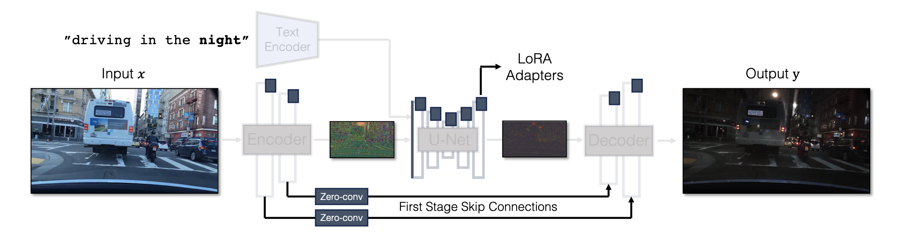
Generator Architecture

Slide 15
Incorporating Conditioning Input
Challenges with Additional Encoder:
Adding condition encoder branches can lead to conflicts, deteriorating output quality.
Extra adapter branches often result in conflicts between noise and conditional input, affecting downstream features in the decoder.
Direct Conditioning Input:
Propose feeding conditioning input directly to the network for better results.
Direct conditioning influences the structure of the generated image significantly, improving output quality.
Addition of LoRA weights to various layers in the U-Net allows adaptation to new conditioning.

Slide 16
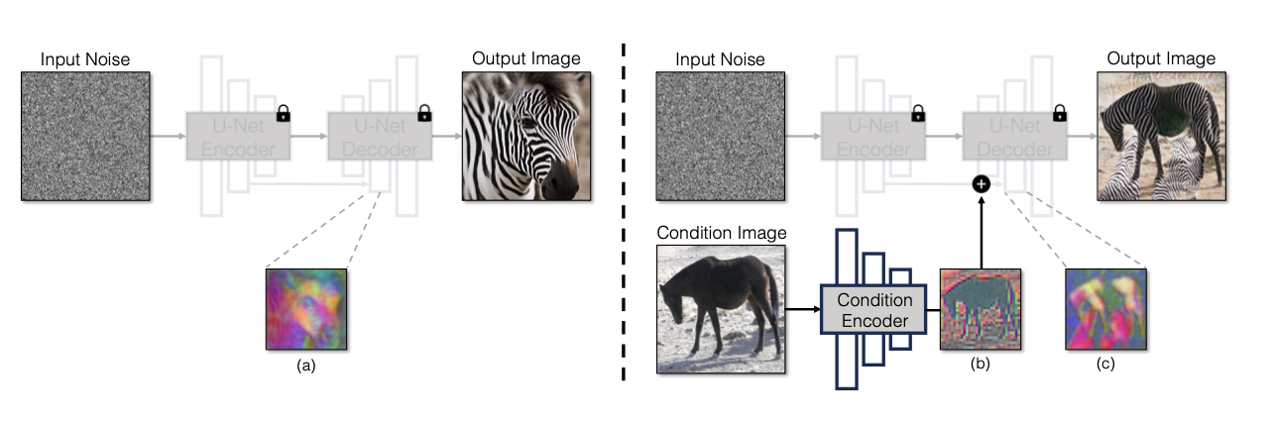
Process of incorporating the conditioning input into the model.

Slide 17
Preserving Input Details – Skip Connection
Implementation of skip connections to aid in retaining fine details during transformations.
Ensuring detail retention throughout the transformation process for enhanced fidelity in the output images.

Slide 18
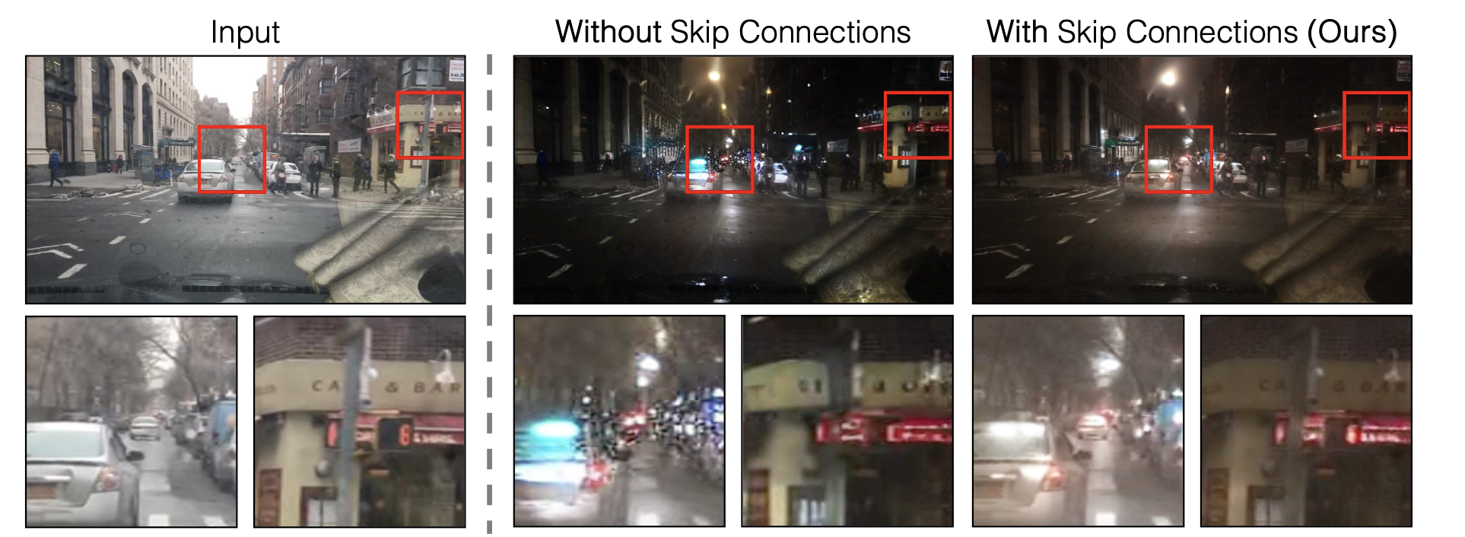
Skip Connections help retain details

Slide 19
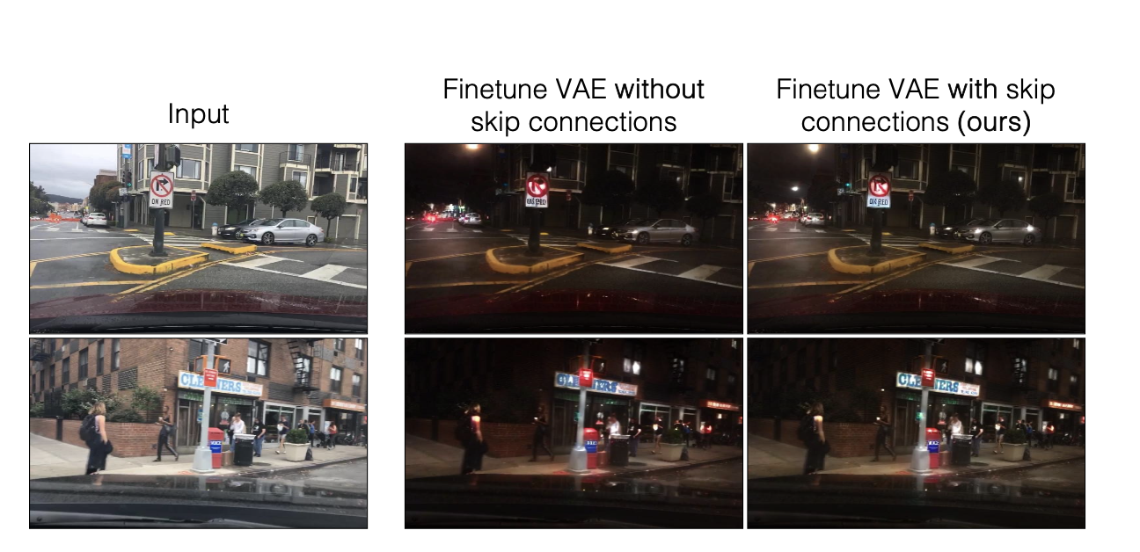
Finetuning encoder-decoder without skip connections

Slide 20
Unpaired Training
Utilization of Stable Diffusion Turbo network for rapid image changes in one step, ensuring efficiency and speed in image translation.
Guaranteeing fidelity and realism of translated images through the one-step process facilitated by the Stable Diffusion Turbo network.
Base Network: Utilizing Stable Diffusion Turbo (v2.1) with one-step inference.
Modified CycleGAN: Integrating our generator into a modified CycleGAN formulation for unpaired translation.
Translation Functions: Two functions, G(x, cY) and G(y, cX), with different captions for each task.
Training Approach:
Cycle Consistency Loss (Lcycle): Ensures translated images revert back to themselves.
Adversarial Loss (LGAN): Matches translated outputs with target domains.
Objective Function: Combines cycle consistency, adversarial, and identity regularization losses.

Slide 21
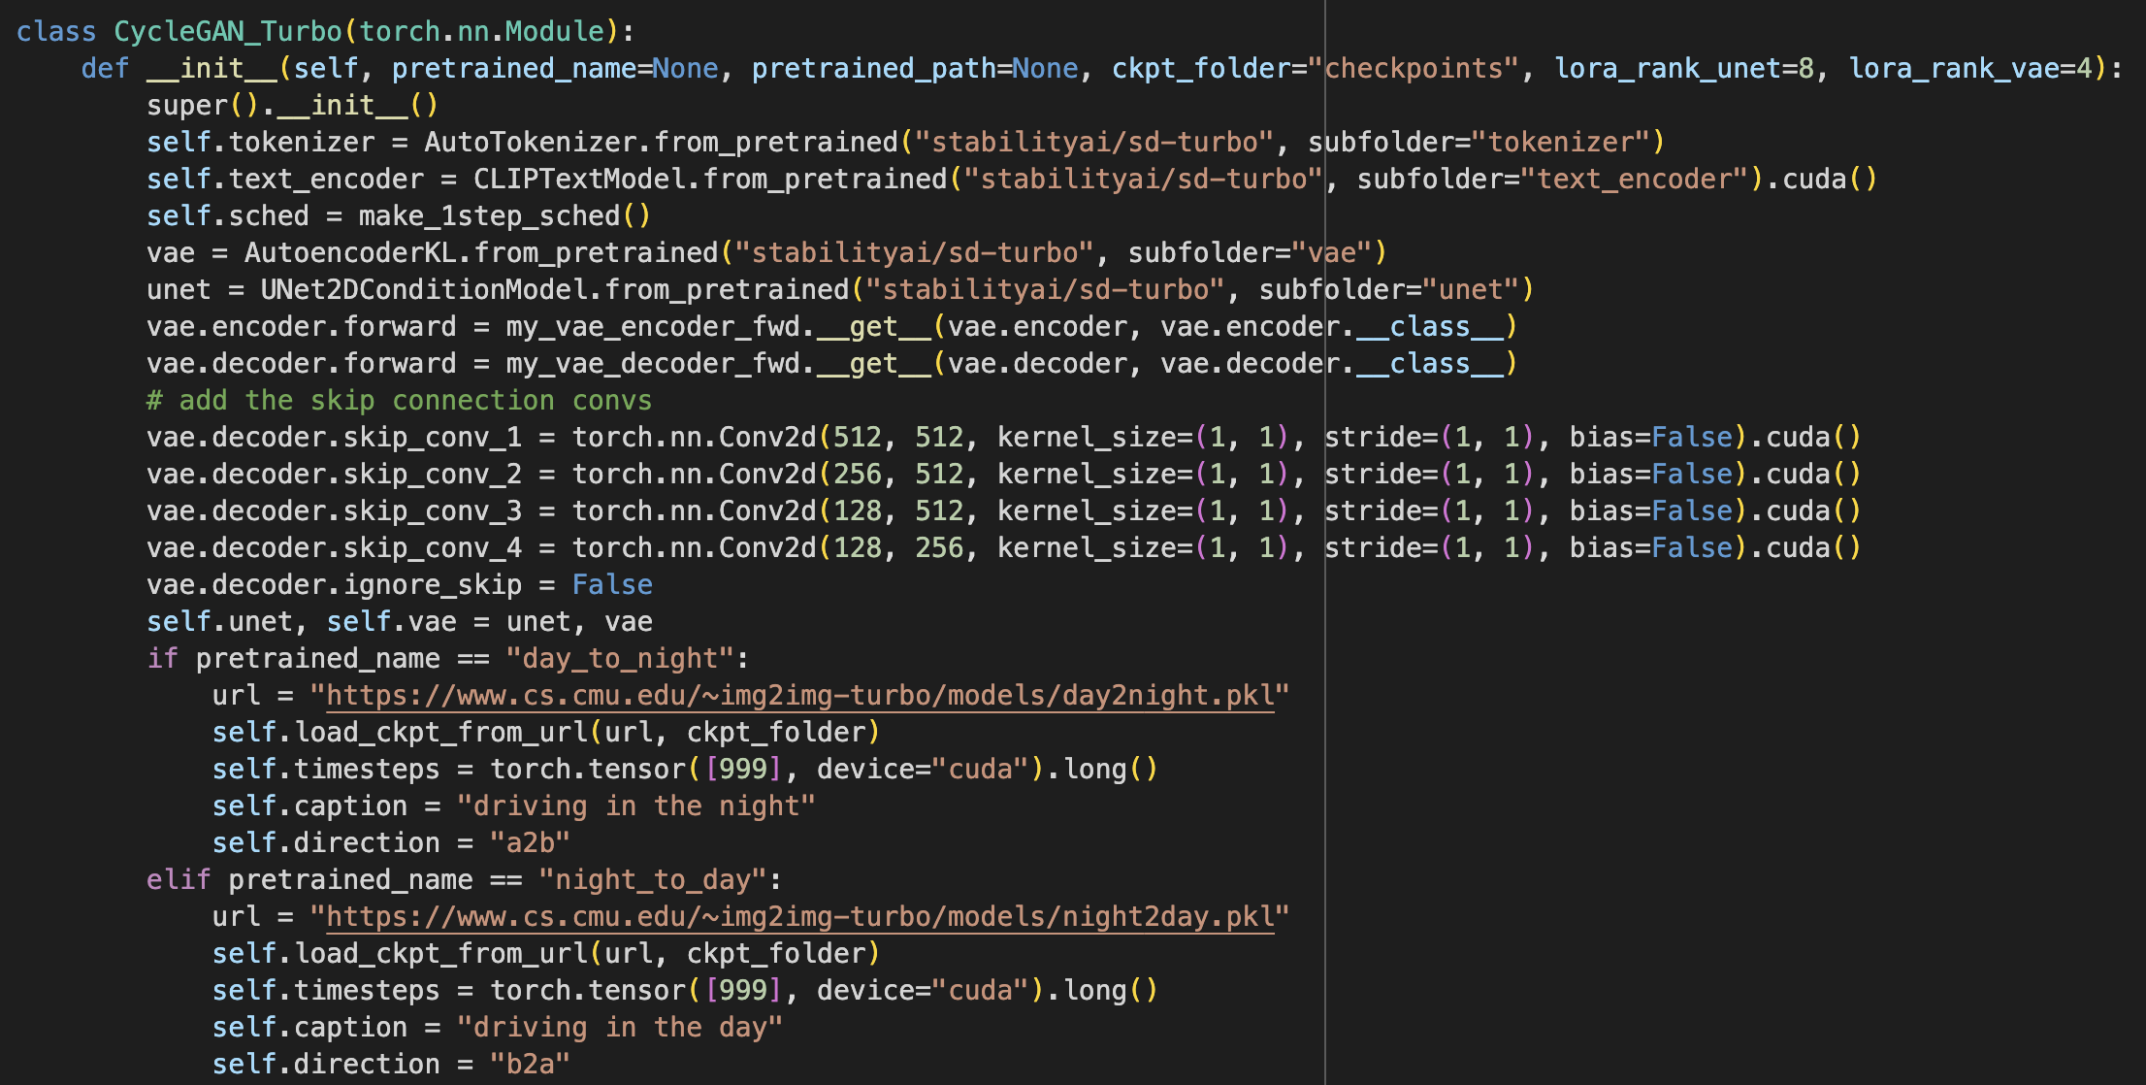
Code Snippet

Slide 22
Extensions
Training with paired images to enhance the model's accuracy and performance across different translation tasks.
Introducing diversity controls to enable the generation of diverse and creative image outputs, further expanding the model's capabilities.

Slide 23
Explanation about the Equations
Explanation of key equations guiding the training process to ensure translation accuracy, realism, and fidelity to original images.
These equations encompass various loss functions such as cycle consistency loss, adversarial loss, and identity regularization loss.
The combination of these equations forms the basis for optimizing the model during training, enabling it to produce high-quality translations while maintaining consistency and fidelity to the original images.

Slide 24
Experimental Evaluation
Comparative Evaluation: Compare the proposed method against existing approaches to assess its performance and effectiveness.
Testing of Individual Components: Evaluate each component of the method independently to understand its contribution to the overall performance.
Evaluation Criteria: Define specific criteria such as image quality, fidelity, and efficiency to assess the performance of the method comprehensively.

Slide 25
Comparison to Unpaired Methods
Performance Evaluation: Thorough comparison of the model's performance against existing unpaired methods.
Tasks Assessment: Evaluation spanned across both simpler and complex tasks to assess versatility.
Human Preference Studies: Consistent preference in human preference studies underlined the effectiveness of the model.
Robustness Demonstrated: The model showcased robust performance across various tasks, indicating its potential for real-world applications.

Slide 26
Ablation Study
Assess the impact of key model components.
Components Analyzed:
Pre-trained Weights
Structural Input Variations
Skip Connections
Trainable Encoder and Decoder
Findings:
Pre-trained weights influence initialization and convergence.
Different structural input methods affect image integrity.
Skip connections aid detail retention and fidelity.
Trainable encoder and decoder enhance adaptability.
Conclusion: Insights into optimizing model configurations.

Slide 27
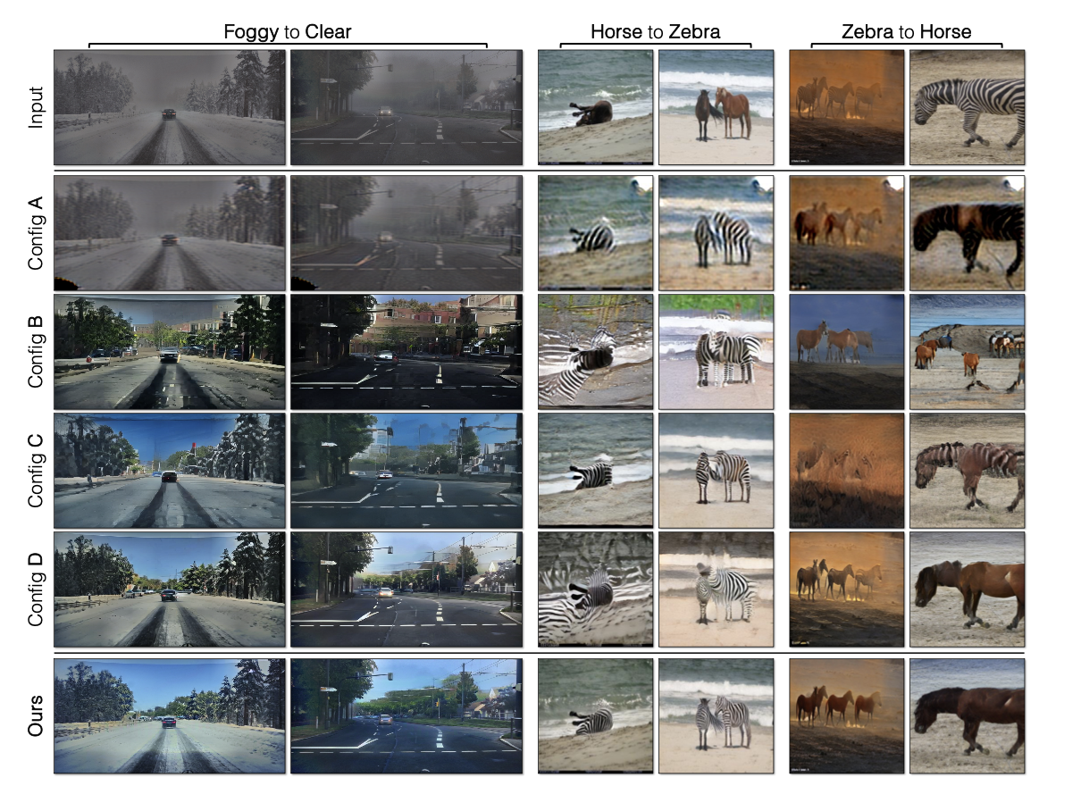
Ablating individual components

Slide 28
Extensions
Paired Translation:
Improve accuracy with paired images.
Expand capabilities with direct correspondences.
Diverse Outputs:
Enable varied image generation.
Enhance creativity and versatility.
Creative Possibilities:
Promote experimentation and innovation.
Create engaging content across domains.
Model Versatility:
Broaden applicability to diverse tasks.
Impact fashion, design, and virtual reality.

Slide 29
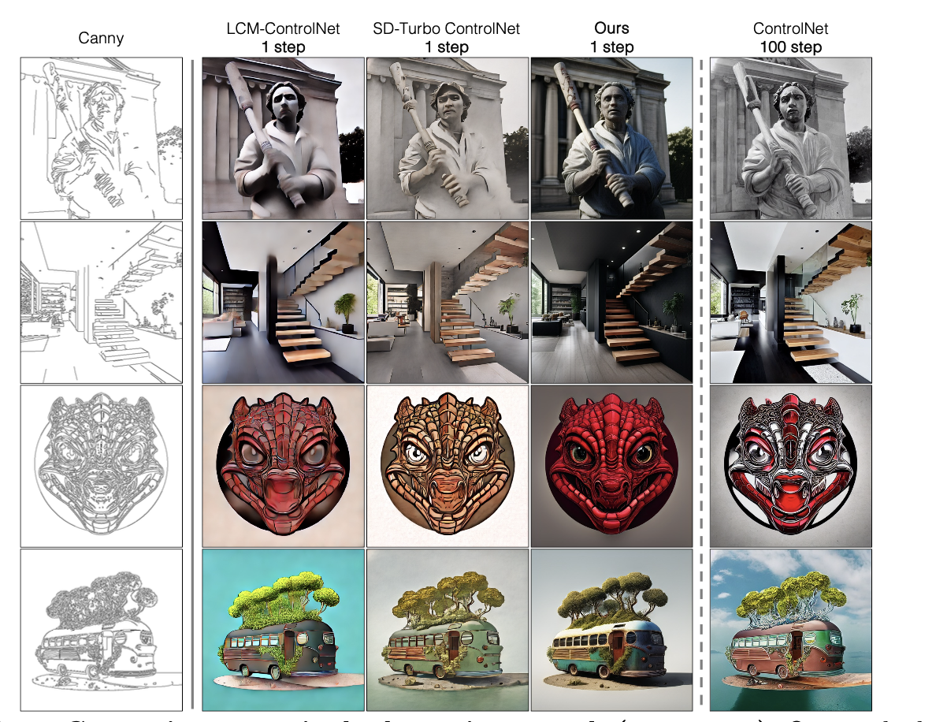
Comparison on paired edge-to-image task(512 X 512)

Slide 30
Discussion and Limitations
Flexibility and efficiency of one-step pre-trained models
Limitations include lack of precise control over guidance strength

Slide 31
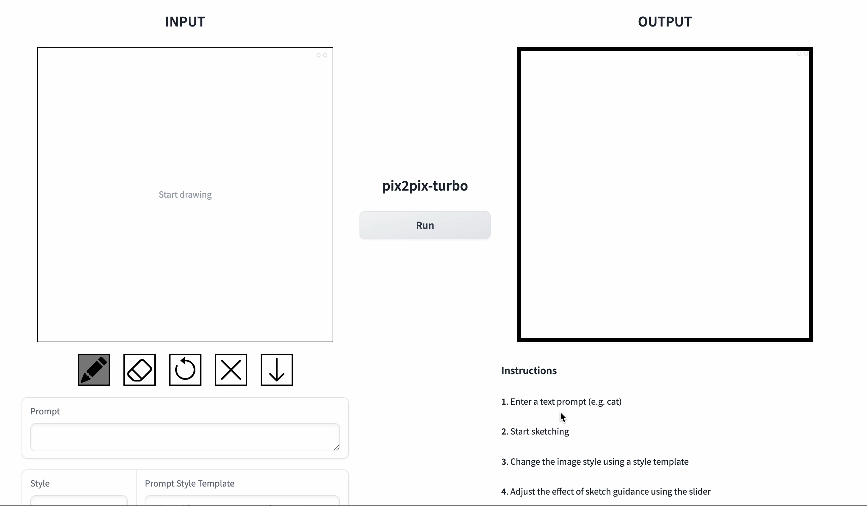
Hugging Face Demo – img2img-turbo-sketch

